Slide 1


Slide 2
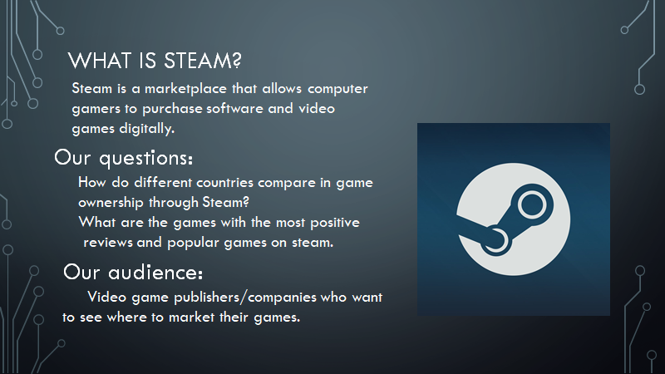

Slide 3

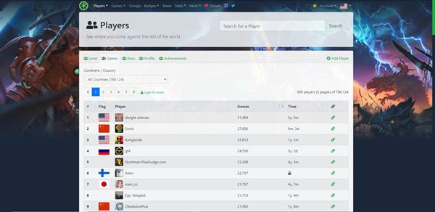
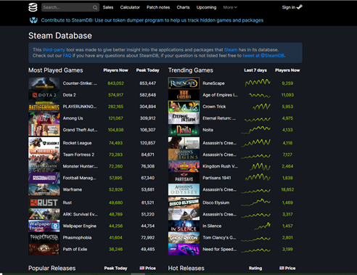
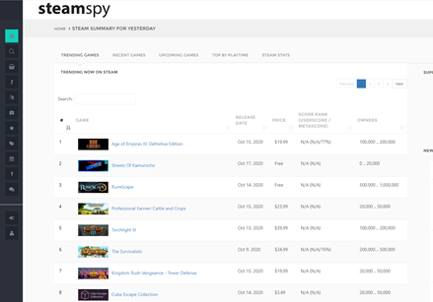
https://gamedb.online/
https://steamdb.info/
https://steamspy.com/
Notes:
Steam offers free access to Steam API, but it is rather complex and others have built their own sites and done a lot of groundwork, so instead we used:
SteamSpy - sales per game / steam ID
SteamDB - game ratings
GameDB - games owned per country/state
Steam ID is a numeric ID assigned to everything on sale in the Steam storefront, makes it easy to join sales/ratings data from SteamDB/SteamSpy

Slide 4

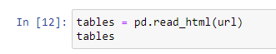
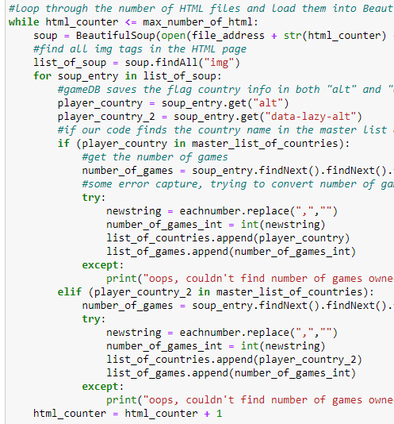
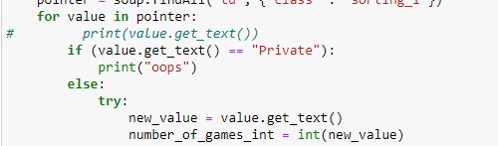
Scraping SteamDB
Scraping GameDB
Handling when users mark their data private
Notes:
Some sources (SteamDB) were easily read by Pandas and converted quickly/easily into a Dataframe
Other sources (GameDB) heavily used JavaScript and dynamically displayed tables, making it difficult for Pandas/BeautifulSoup to read the live websites. We had to use BeautifulSoup with static (saved) copies of the websites, building code to navigate the tables. Adding to the complexity, Steam allows users to hide location data and game ownership data. This is passed to our sources via Steam API, and required us to build handling for instances where we not get returned valid data.
State data was not included in the table, instead demarcated in the URL

Slide 5


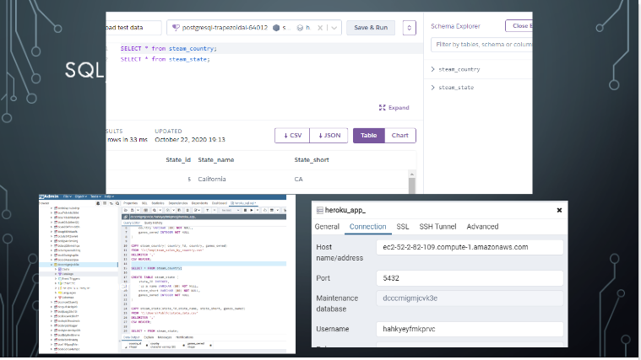
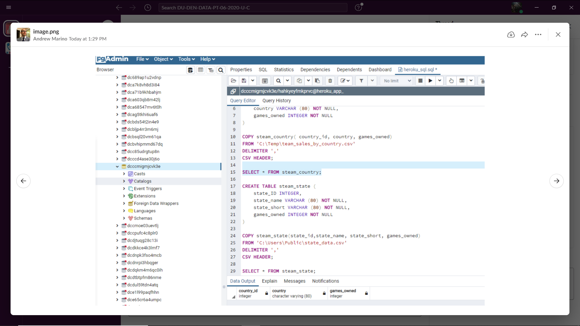

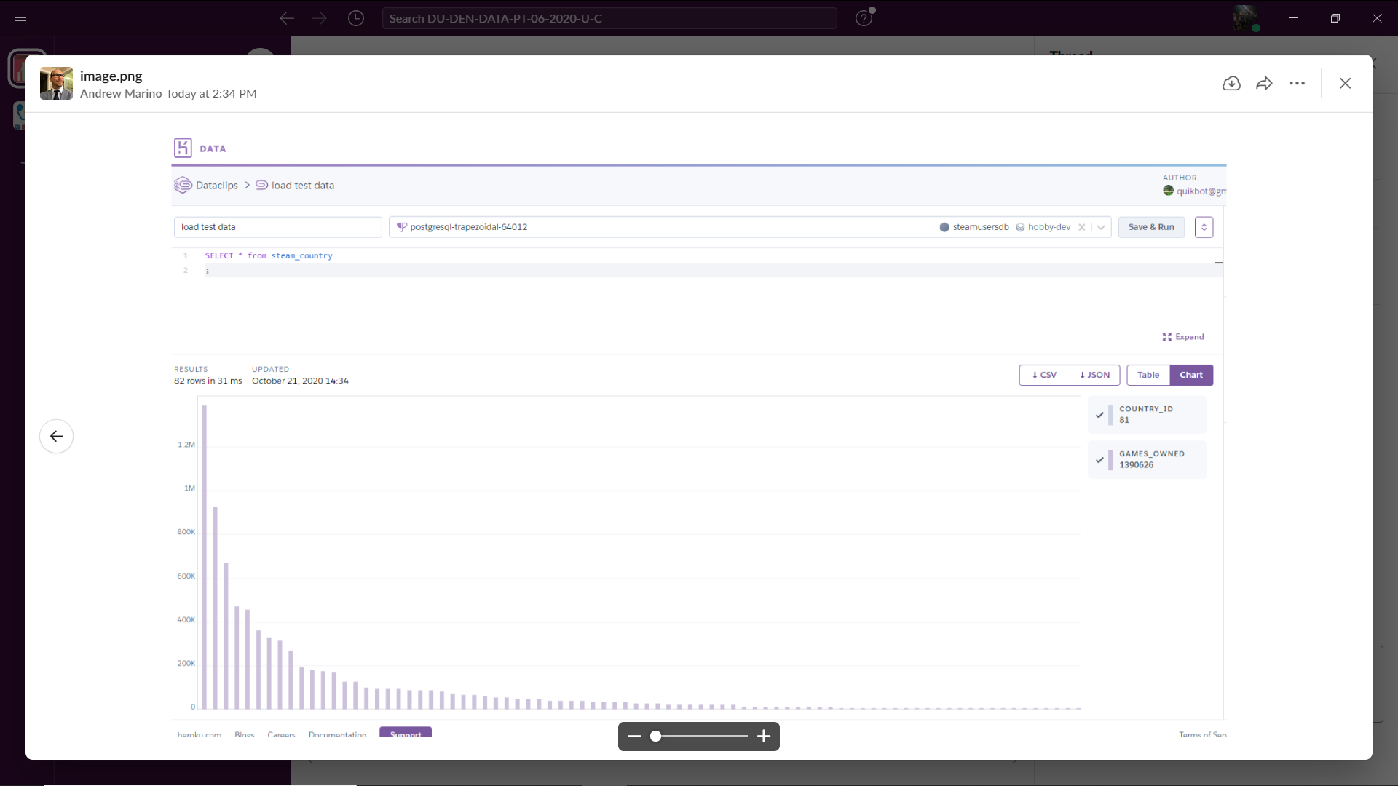

Hosted on heroku

Slide 6
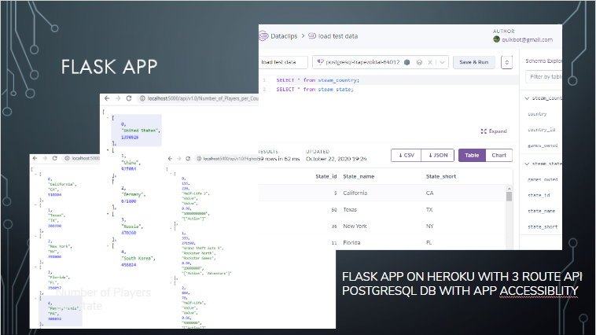


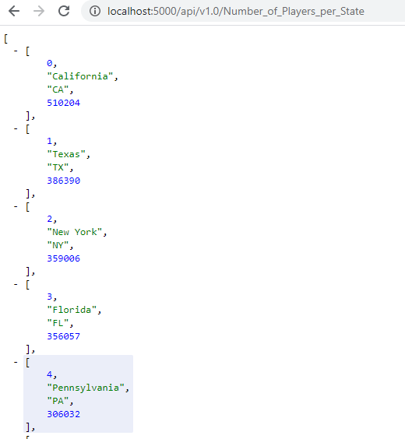
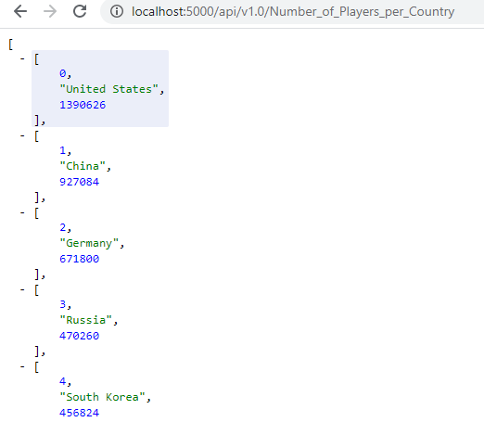
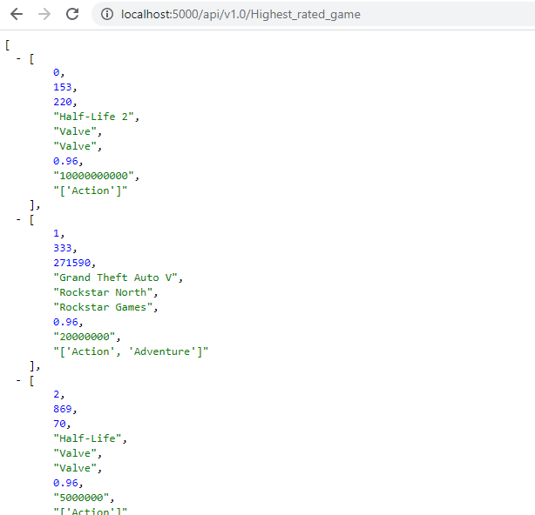
Number of Players per State
Number of Players per Country
Positive Rated Games for the most popular games

Slide 7

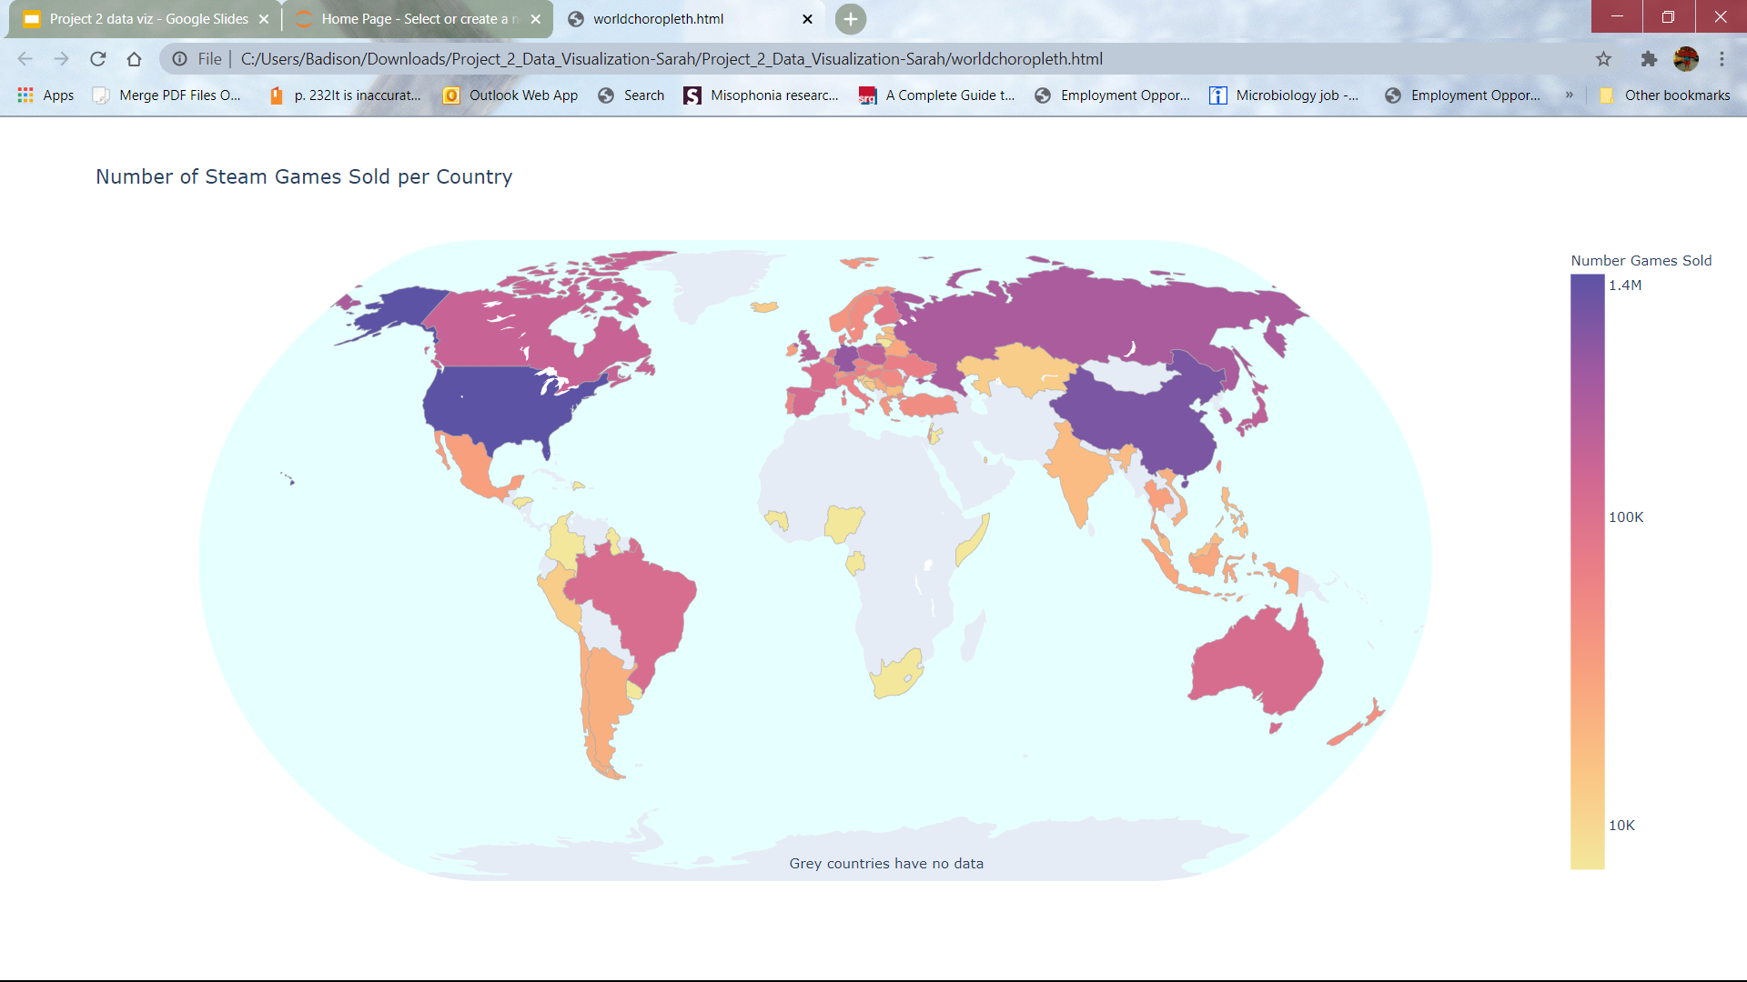
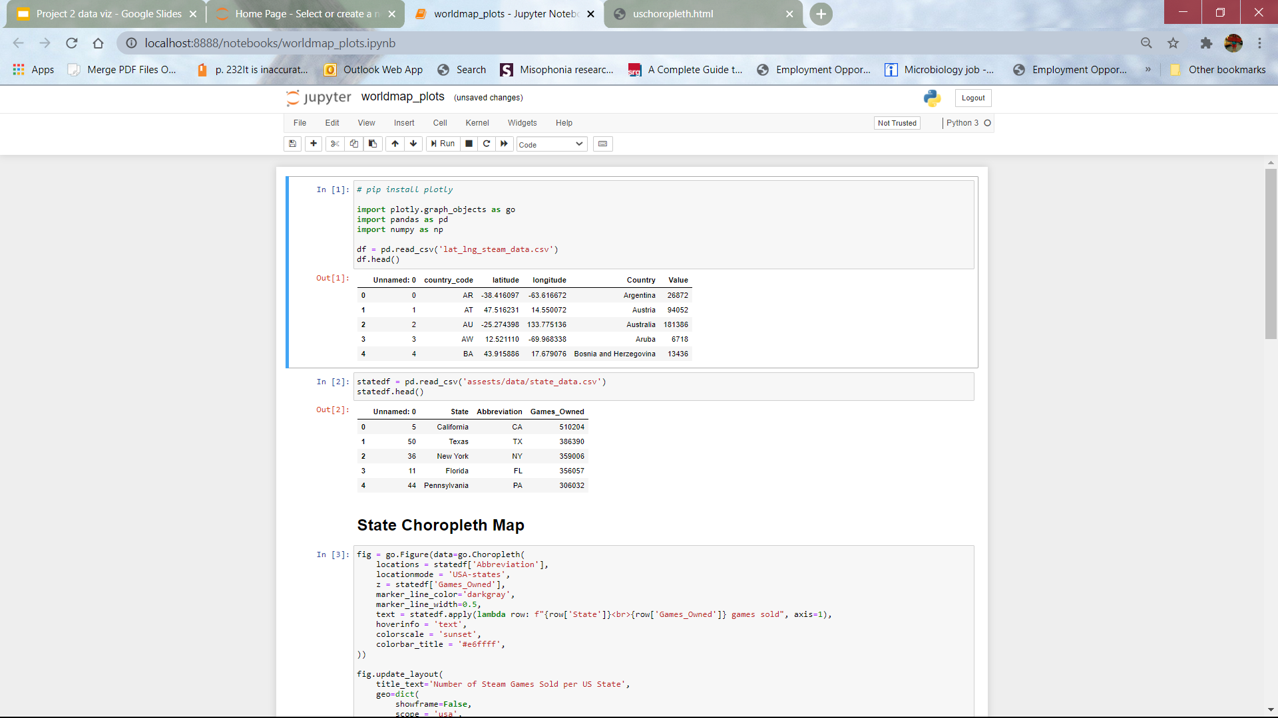
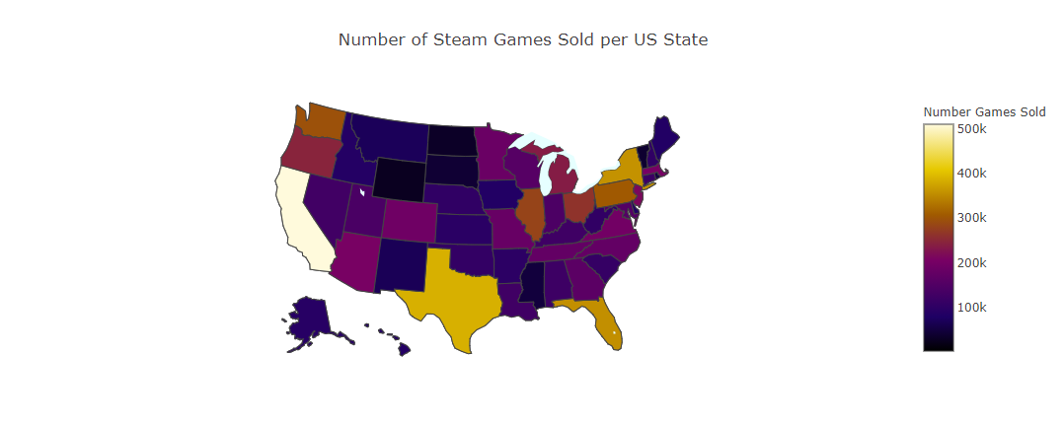
Choropleth
First created the maps using Plotly in Jupyter Notebook as that was easiest to test and make adjustments
Then reworked in JavaScript to deploy on website - some differences between the two that had to be worked around
Interactive with mouseovers & dragability
These maps show which areas both worldwide and in the US have the most steam games sold
Jupyter Version
JS Version

Slide 8

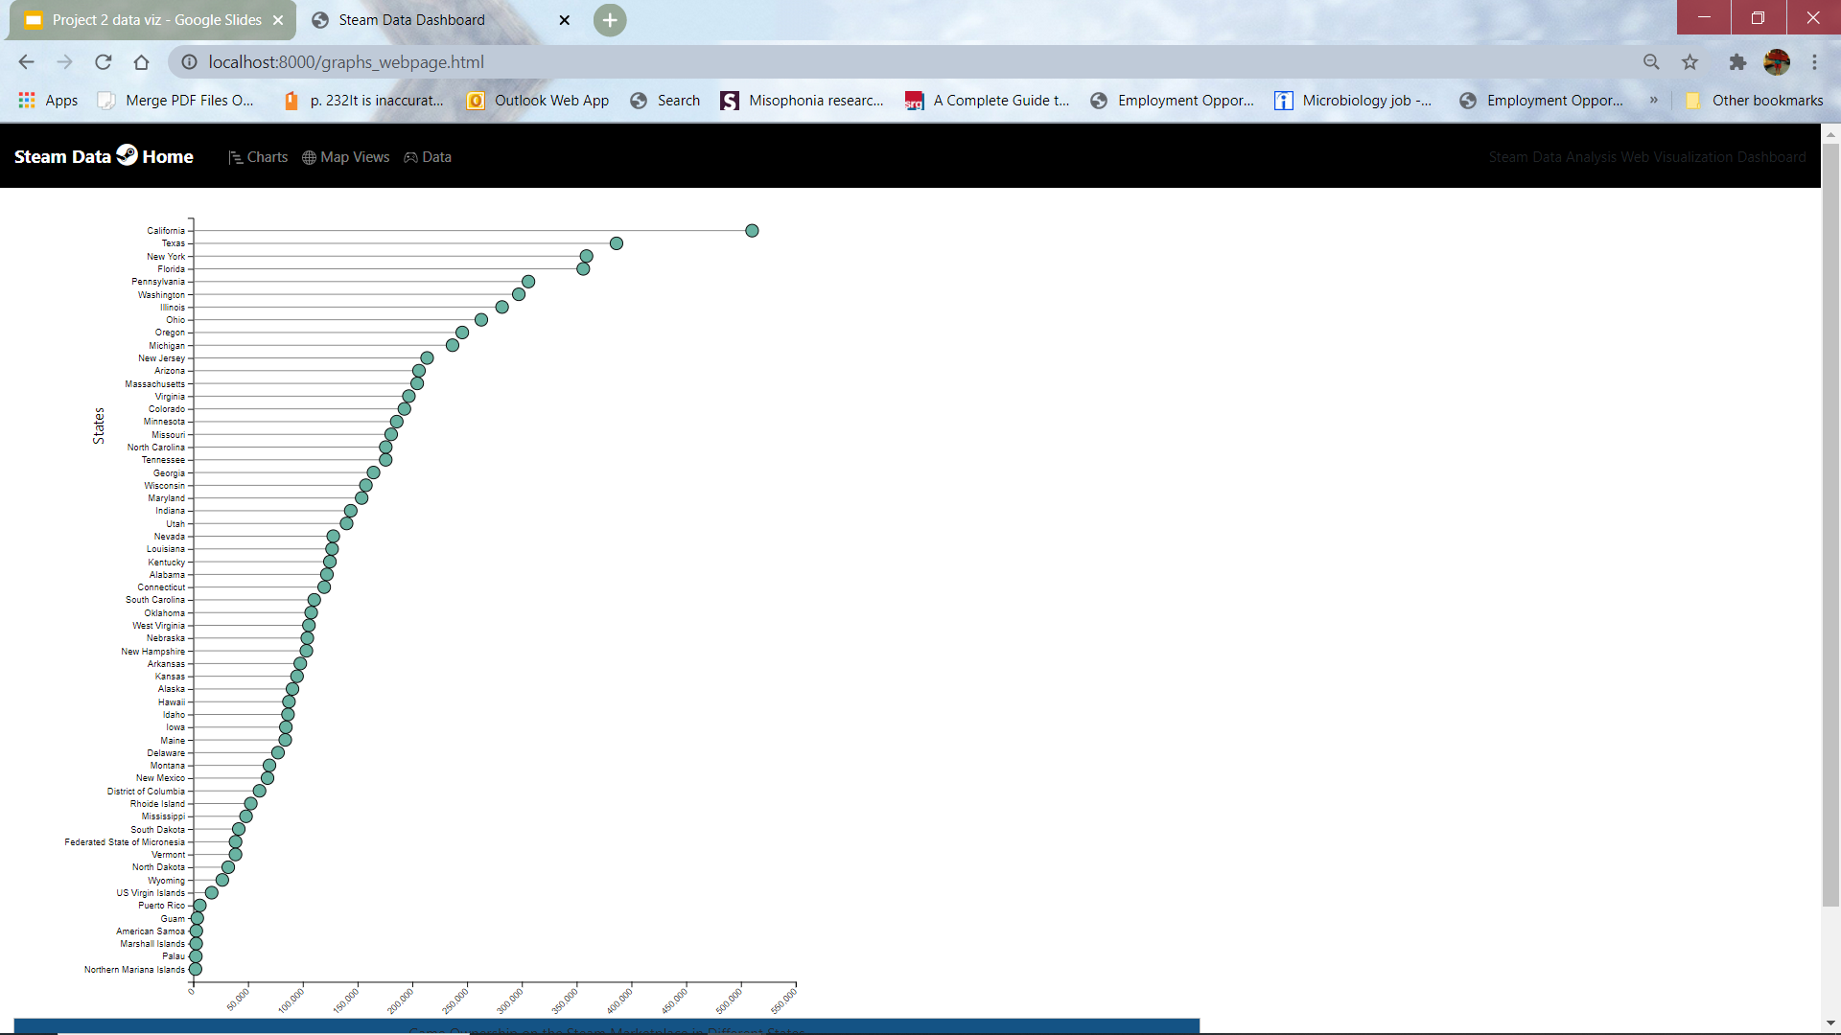
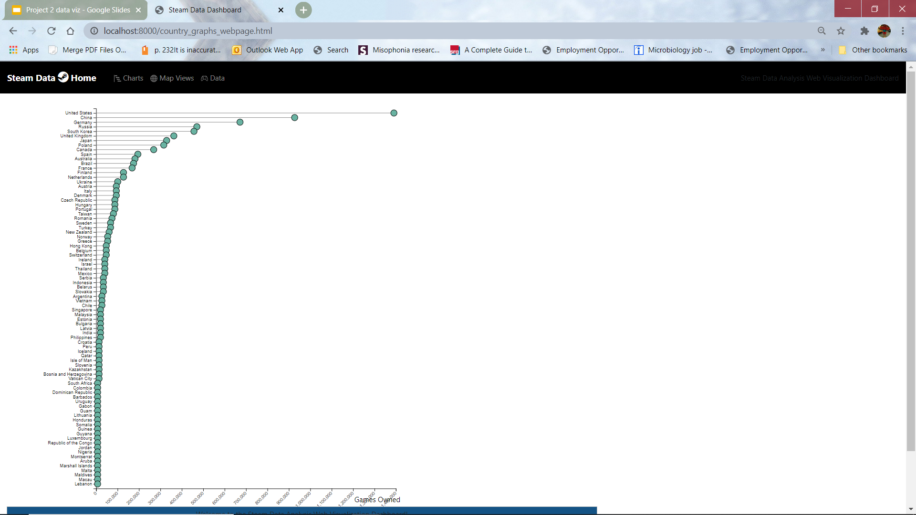
With the data scraped from GameDB, we made graphs comparing number of games owned on steam between different countries and U.S. States.
The graphs showed that globally the United States had the highest game ownership and California had the most game ownership within the U.S.
We used D3.js to add a transform animation to the graphs and used tooltips so when each data point is pressed it displays the number of games owned.

Slide 9
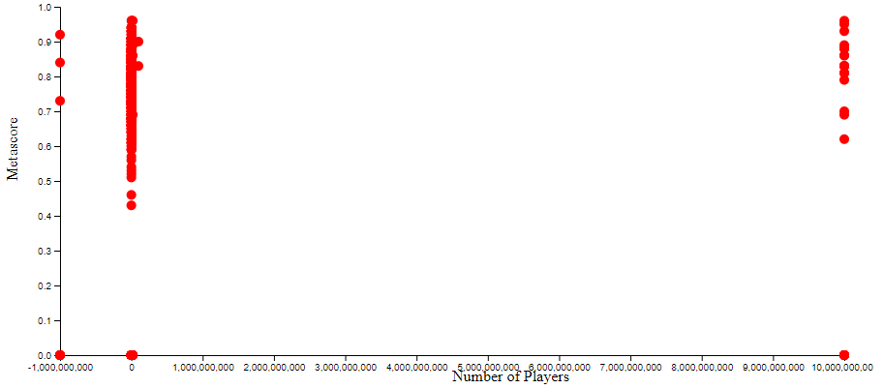
This is a scatter plot of metascore(rating of the games) and the number of players. As one could see, there is not any real correlation with the data. The data was from scraped from our ETL Project from SteamDB and SteamSpy. Using JS, we also used a transform to animate each data point to come onto the graph.

Slide 10

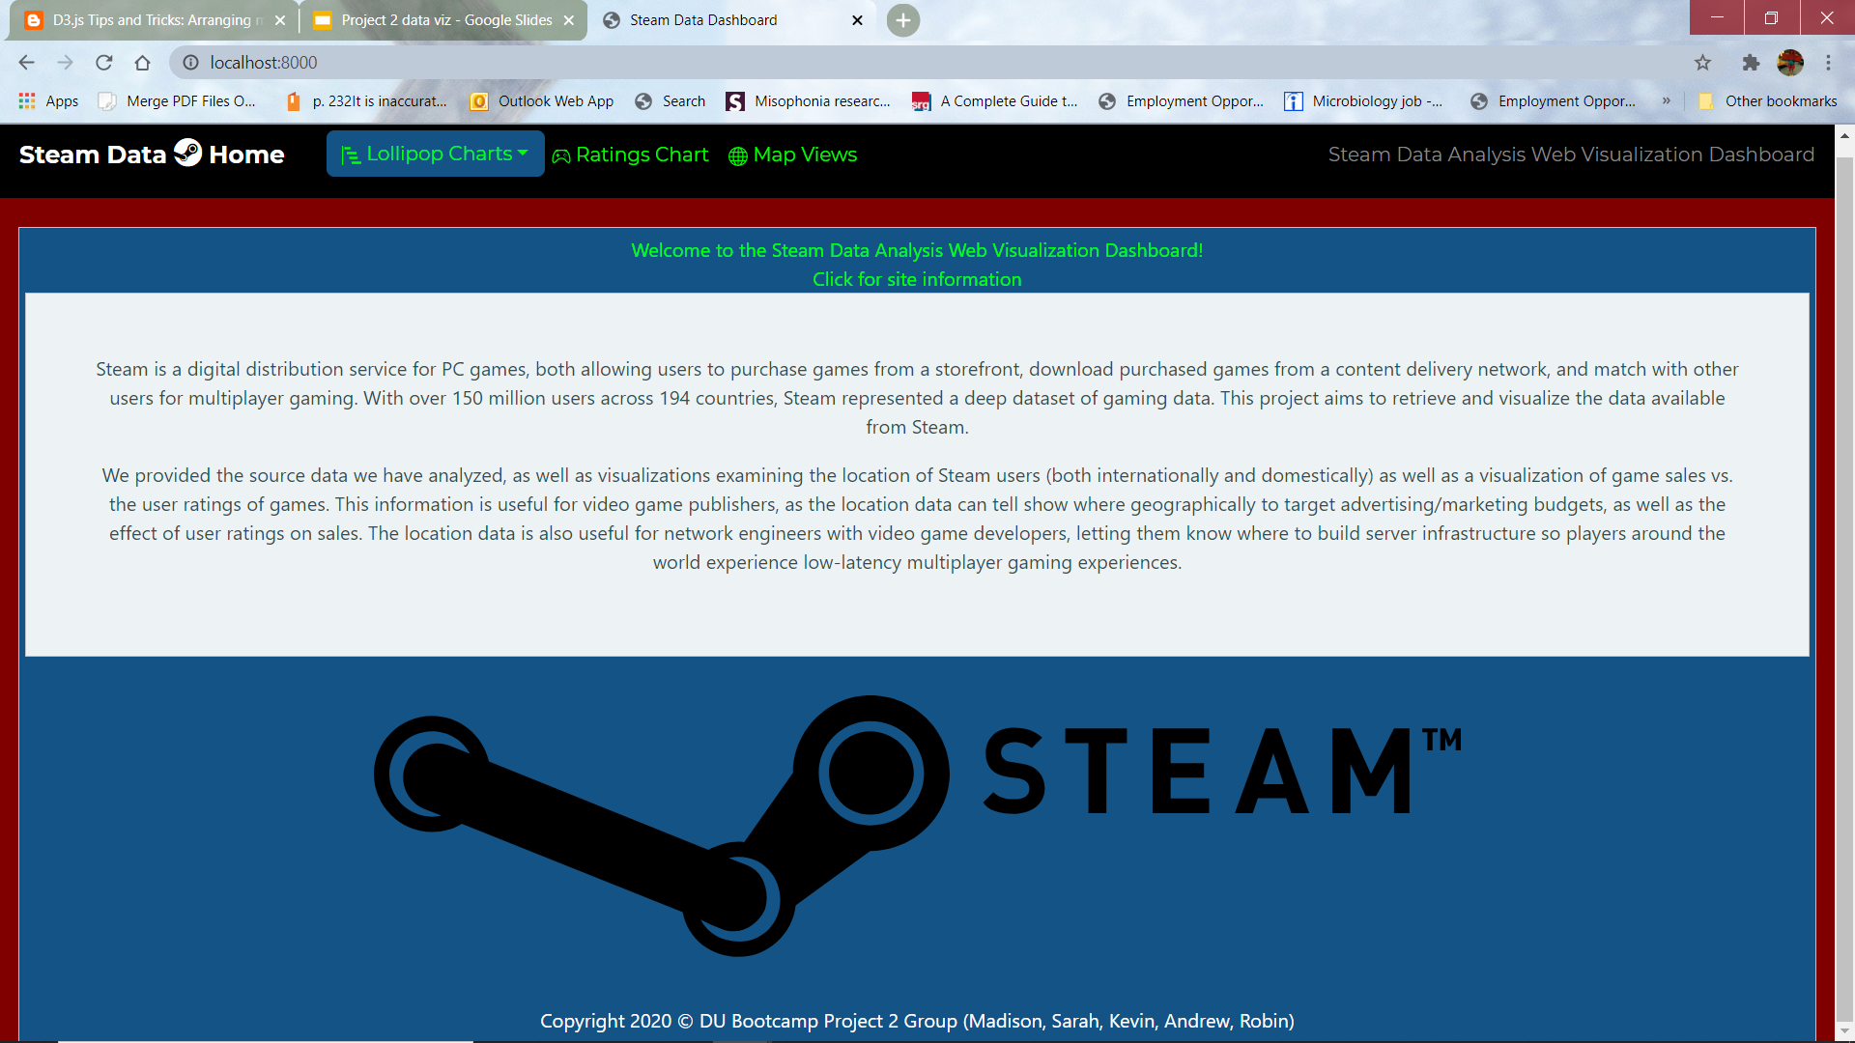

Slide 11


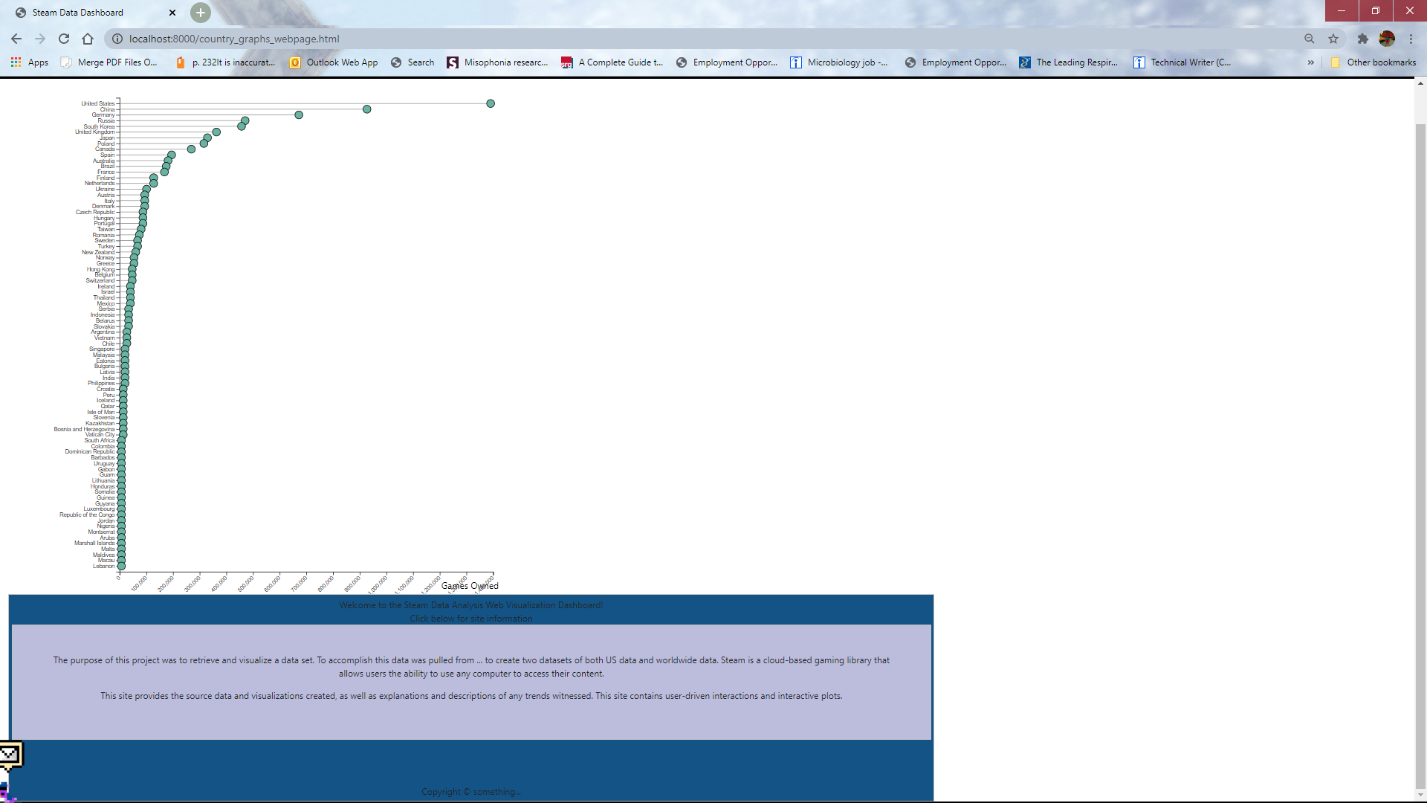
We used JQuery to which makes our HTML manipulative.
We utilized the jQuery slideToggle()Method to create interactive captions.

Slide 12


Scraping the data from dynamically-generated JavaScript tables.
Getting the data into a SQL server database so we could create the Flask app.
Displaying D3.js graphs on the same webpage without them superimposing on top of eachother.
Converting the choropleth maps from JupyterNotebook to JS

Slide 13

Why is Steam not utilized in Japan and South Korea? Since Japan and South Korea are huge gaming markets, how could Steam be marketed better in Japan and South Korea?
Is there a better way to compare sales to game ownerships?
How does the Steam dataset compare to dataset from the Nintendo, Microsoft Xbox, and Sony Playstation especially in the markets who underutilize Steam?
How does other countries compare lack of ownership due to computer resources?

